Slide 1


IT343: Operating System
July – November 2020
Chapter – 7(Part-2)
Memory Management
Devang Patel Institute of Advance Technology and Research

Slide 2
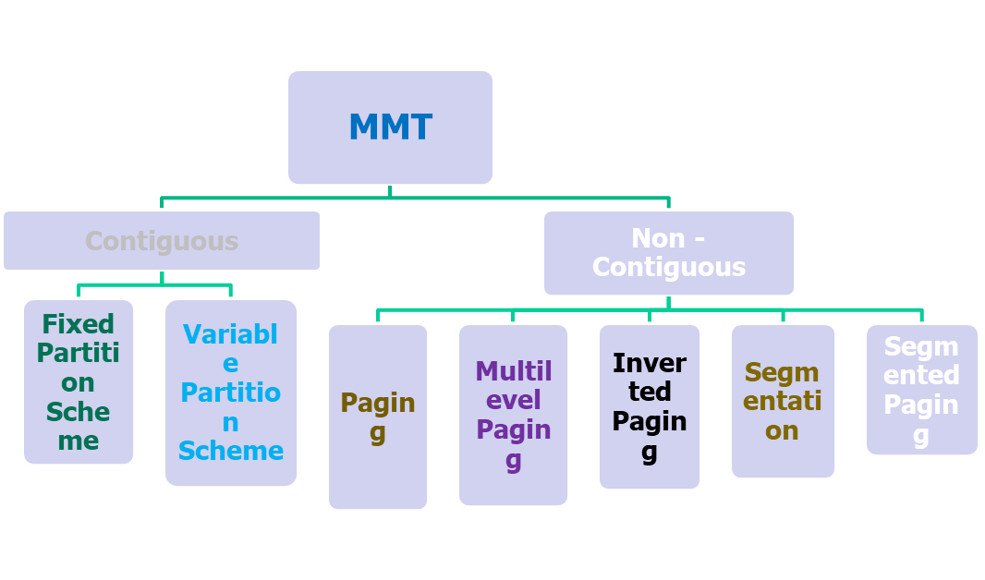
Memory Management Techniques (MMT)

Slide 3
Non-contiguous memory allocation
Allocation of memory space to process in non-sequential manner is called Non-contiguous memory collection
There are various Non-contiguous memory allocation techniques:
1) Paging
2) Multilevel Paging
3) Inverted Paging
4) Segmentation

Slide 4
Paging
Paging is a memory management technique that permits the physical address space of a process to be noncontiguous
Paging avoids external fragmentation and the need of compaction
Address Space means- | Set of memory location/ words cells

Slide 5
Paging
rIt always generate Logical Address(LA) but your process resides in Physical Address(PA)
The mapping of logical address to physical address is called paging
Logical and physical address space are represented in form of words
Logical and physical address is represented in form of bits
Logical address space also called Virtual Address Space

Slide 6
Paging
If Physical Address(PA) = 19 bits. Find PAS?
then PAS =2^19 words or 512K words
If PAS = 256M words or 2^28 words. Find PA?
then PA = 28 bits
If Logical Address(LA) = 37 bits. Find LAS?
then LAS=2^37 words or 128G words
If LAS = 512M words or 2^29 words. Find LA?
then LA = 29 bits

Slide 7
Basic Method of Paging
Physical memory is divided into fixed size blocks called frames
Logical memory is also divided into blocks of same size called pages
To run a program of size n pages, need to find n free frames and load program, but these n frames may be located in noncontiguous manner.
Set up a page table to translate logical to physical addresses.

Slide 8

Paging model of logical and physical memory of a process
Page no.
Frame no.
Process A

Slide 9
Example of paging
Here process A is divided into pages page1, page2, page3, page4 and MM is divide into 8 frames .
Here size of each page is 100MB, and size of each frame in memory is 100mB.

Slide 10
Paging Concepts
Pages are loaded into frames.
Page size and frame size are equal, which is defined by the system hardware.
Process will be divided into pages according to size of process.
All pages of process will be loaded into the frames of MM.

Slide 11
NCG Allocation policy is 4 step process
Organization of LAS/VAS
Organization of PAS
Organization of MMU
Address Translation Algorithm

Slide 12
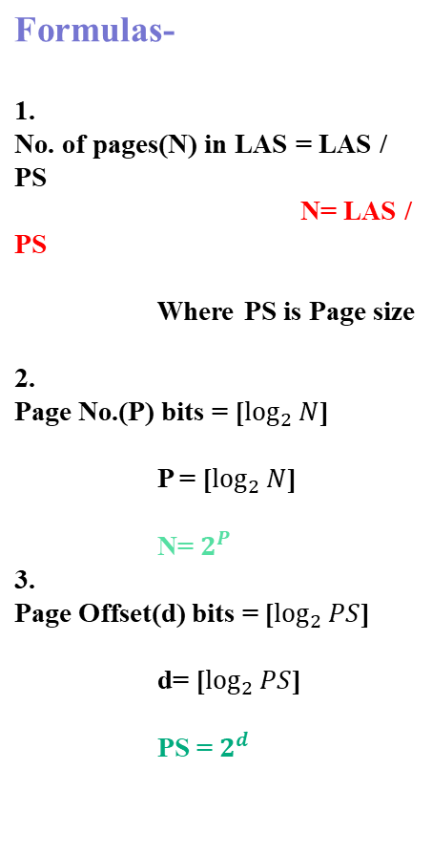
1. Organization of LAS/VAS
Logical address
Logical address space divided into equal size of pages.
Logical address is divided into two parts
Page number (p)
Page offset (d)
Page number: used as an index into page table
Page offset: is the displacement within the page
<-------------m--------------→
Page no.
Page offset
P
d
m-n
n

Slide 13
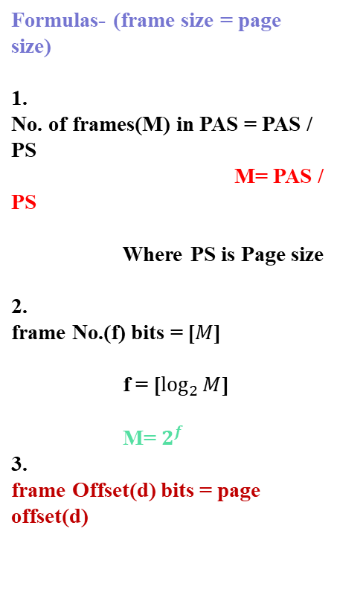
2. Organization of PAS
Physical address
Physical address space divided into equal size of frames.
Physical address is divided into two parts
Frame number (f)
Frame offset (d)
Frame number: used as an index into physical memory
Frame offset: used to index into single frame
<--------------m--------------→
Frame no.
Frame offset
f
d
m-n
n

Slide 14
3. Organization of MMU(Page Table)
Each process is associated with its own page table
Page tables are shared in MM.
Page tables are organized in the form of entries
No. of entries in Page table = no. of page in LAS
Page table entries contain frame size
Page table entries are in multiple of Bytes = ‘e’ bytes
Page table size(in Byte)= N * e Bytes

Slide 15
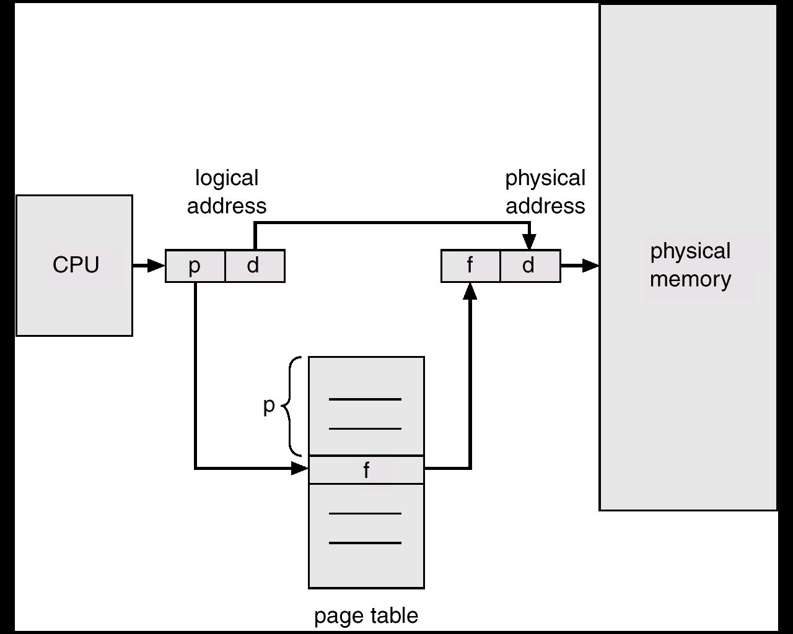
4. Address Translation architecture

Slide 16
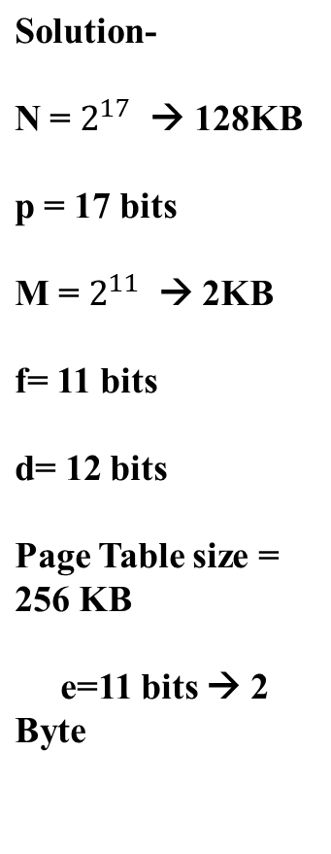
Example-1
Given Logical Address(LA)=29 bits,
Physical Address(PA) =23 bits &
Page size =4KB
Find
No. of pages in LAS
Page number(p) in bits
No. of frames in PAS
Frame number(f) in bits
Offset(d)
Page Table size

Slide 17
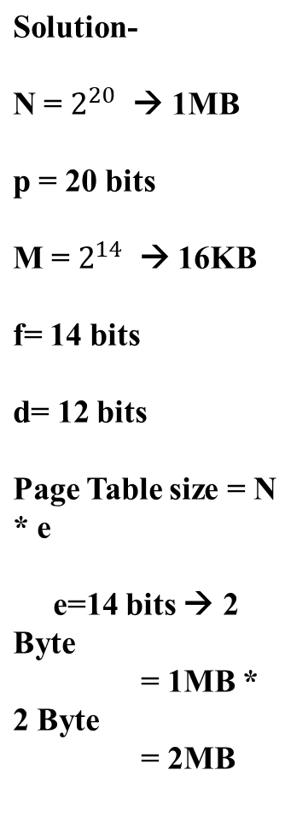
Example-2
Given LA = 32 bits
Physical Memory = 64 MB
PS = 4KB
What is the Page Table size approx. in Byte?

Slide 18
Example-3
Find out Page Table size in Bytes for the data given below. Logical address is 34 bits.
Main Memory size is 1GB.
The size of each page is 2KB.
24MB

Slide 19
Page Table
Page table translate page number into corresponding frame number.
Here logical address is combination of page no and displacement (Offset).
Displacement is defined by the system automatically.
According to Page no, page table will search and frame number will be find and combination of frame no and displacement will be physical address.

Slide 20
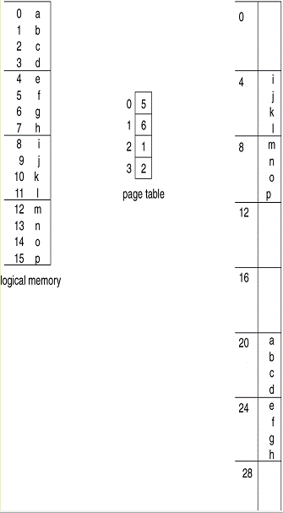
Example of paging

Slide 21
Consider the memory shown in previous slide
Using a page size of 4 bytes and a physical memory of 32 bytes (8 pages), we show how the user's view of memory can be mapped into physical memory.
Logical address 0 is page 0, offset 0. Indexing into the page table, we find that page 0 is in frame 5. Thus, logical address 0 maps to physical address 20 (= (5 x 4) + 0).
Logical address 3 (page 0, offset 3) maps to physical address 23 (= (5x4) + 3).
Logical address 4 is page 1, offset 0; according to the page table, page 1 is mapped to frame 6. Thus, logical address 4 maps to physical address 24 (= (6x4) + 0).
Logical address 13 maps to physical address 9.

Slide 22
Hardware support for paging
Each operating system has its own methods for storing page tables.
One page table is allocated for each process
Page table is kept in main memory
The hardware implementation of the page table can be done in several ways.

Slide 23
How should we store the page table?
Registers: Page table is a set of dedicated registers built with very high speed logic.
Memory: Page table stored in main memory but pointer (PTBR) to the page table is stored in CPU register.
TLB (Translation Look-aside Buffer): A fast fully associative memory that stores page numbers (key) and the frame (value) in which they are stored. – if memory accesses have locality, address translation has locality too. – typical TLB sizes range from 8 to 2048 entries.

Slide 24
1) Page Table: Implemented as a set of Dedicated Registers
In the simplest case, the page table is implemented as a set of dedicated registers.
These registers should be built with very high-speed logic to make the paging-address translation efficient.
Every access to memory must go through the paging map
The use of registers for the page table is satisfactory if the page table is reasonably small (for example 256 entries)

Slide 25
2) Page Table: Stored in Memory
Page table is kept in main memory but pointer to page table (PTBR) is stored in register.
Page-table base register (PTBR) points to the page table.
Page-table length register (PRLR) indicates size of the page table.

Slide 26
Problem: Access a user location requires more time
To access location i, we must first index into the page table, using the value in the PTBR offset by the page number for i.
This task requires a memory access. It provides us with the frame number,
which is combined with the page offset to produce the actual address.
With this scheme, two memory accesses are needed to access a byte (one for the page-table entry, one for the byte).

Slide 27
Performance of paging
Consider main memory access time = “m”
If the page table are kept in main memory then Effective access time = 2*m = (m+m)
First m = access memory using page number to find page table in memory
Second m = page table will give frame number then we can find the process
The problem with this scheme is that is requires two memory accesses to access a byte.

Slide 28
Translation Look-aside Buffer (TLB)
The standard solution to this problem is to use a special, small, fast-lookup hardware cache, called a translation look-aside buffer (TLB).
TLB is a hardware device that will be implemented with the help of high-speed, associative memory
Each entry in TLB consist of two parts
1) Key (page number) 2) Value (frame number)

Slide 29

Paging Hardware with TLB

Slide 30
The TLB is used with page tables in the following way. The TLB contains: only a few of the page-table entries.
When a logical address is generated by the CPU, Its page number is presented to the TLB.
TLB Hit: If the page number is found, its frame number is immediately available and is used to access memory.
TLB Miss: If the page number is not in the TLB a memory reference to the page table must be made. When the frame number is obtained, we can use it to access memory

Slide 31
Paging Performance with TLB
Hit ratio: The percentage of times that a particular page number is found in the TLB is called the hit ratio.
if main memory access time = m
TLB access time = c i.e.(c<m)
Hit ratio = x
Then, Effective access time =
[ x * (c+m) + (1-x) * (c+2*m)]

Slide 32
Example: performance evaluation of paging with or without TLB
Consider a system with TLB access time = 20ns,
the main memory access time = 100ns.
The TLB hit ratio is 95%.
What is the effective memory access time with TLB and without TLB?
Without TLB: EAT = 2*M = 2*100 = 200ns
With TLB: EAT = 95/100 *(20+100) + 5/100*(20+2*100) =114+11
= 125ns

Slide 33
Memory Protection in paged environment
Memory protection implemented by associating protection bit with each frame to indicate if read-only or read-write access is allowed
  Can also add more bits to indicate page execute-only, and so on
Valid-invalid bit attached to each entry in the page table:
  “valid” indicates that the associated page is in the process’ logical address space, and is thus a legal page
  “invalid” indicates that the page is not in the process’ logical address space
  Or use PTLR
Any violations result in a trap to the kernel

Slide 34

Valid (v) or Invalid (i)
Bit In A Page Table

Slide 35
Shared Pages
An advantage of paging is the possibility of sharing common code
Consider a system that supports 40 users, each of whom executes a text editor.
If the text editor consists of 150 KB of code and 50 KB of data space, we need 8,000 KB to support the 40 users.
If the code is reentrant code (or pure code), however, it can be shared, as shown in Figure

Slide 36
Reentrant code is non-self-modifying code; it never changes during execution.
Thus, two or more processes can execute the same code at the same time.
Each process has its own copy of registers and data storage to hold the data for the process's execution.
The data for two different processes will, of course, be different.

Slide 37
Shared Pages
Shared code
  One copy of read-only (reentrant) code shared among processes (i.e., text editors, compilers, window systems)
  Similar to multiple threads sharing the same process space
  Also useful for interprocess communication if sharing of read-write pages is allowed
Private code and data
  Each process keeps a separate copy of the code and data
  The pages for the private code and data can appear anywhere in the logical address space

Slide 38
Shared Pages Example
Here we see a three-page editor
Each page 50 KB in size being shared among three processes.
Each process has its own data page.
Only one copy of the editor need be kept in physical memory.

Slide 39

Shared Pages Example

Slide 40
Shared Pages example
Each user's page table maps onto the same physical copy of the editor
But data pages are mapped onto different frames.
Thus, to support 40 users, we need only one copy of the editor (150 KB), plus 40 copies of the 50 KB of data space per user.
The total space required is now 2,150 KB instead of 8,000 KB—a significant savings.

Slide 41
Advantages of Paging
The paging technique supports time-sharing systems
The paging technique provides a high degree of multiprogramming
There is no problem of external fragmentation in paging
The paging technique allow sharing of common code

Slide 42
Disadvantages of Paging
The size of translational look-aside buffers is limited
The additional cost is involved with translational look-aside buffer
The paging technique suffers from internal fragmentation
You need to use inverted page table if the size of the page table gets very large
There is additional resource consumption and memory overhead in case of paging

Slide 43
Structure of page table
Hierarchical Paging (Multilevel Paging)
Hashed Page Tables
Inverted Page Tables

Slide 44
Hierarchical Page Tables (Multilevel Paging)
Break up the logical address space into multiple page tables
A simple technique is a two-level page table
We then page the page table

Slide 45
Two-level page tables
Logical Address/ virtual address
master page #
secondary page#
offset
physical memory
master
page table
page
frame 0
physical address
page frame #
offset
page
frame 1
secondary
page table #
secondary
page table # addr
page
frame 2
page
frame 3
page frame
number
…
page
frame Y

Slide 46
Two-Level Paging Example
A logical address (on 32-bit machine with 1K page size) is divided into:
  a page number consisting of 22 bits
  a page offset consisting of 10 bits
nce the page table is paged, the page number is further divided into:
  a 12-bit page number
  a 10-bit page offset
Thus, a logical address is as follows:
where p₁ is an index into the outer page table, and p₂ is the displacement within the page of the inner page table
Known as forward-mapped page table
page number
page offset
p₁
p₂
d
12
10
10

Slide 47

Address-Translation Scheme

Slide 48
Segmentation
Second non contiguous memory allocation technique
“Paging doesn’t preserve user’s view of memory allocation”

Slide 49
Why paging doesn’t preserve user’s view of memory allocation?
Example- program size=1000 word & page size=100 word
How many pages we required?
Which are stored in different places in memory so program is distributed
→ 10 pages

Slide 50
Segmentation
Memory-management scheme that supports user view of memory.It is in different size
A program is a collection of segments. A segment is a logical unit such as:
main program,
procedure,
function,
local variables, global variables,
common block,
stack,
symbol table, arrays
A program divided into unequal/different sizes is called segment.

Slide 51

User view of Program
Logical address is the collection of segments

Slide 52
Logical view of the segmentation
1
1
4
2
3
4
2
3
user space
physical memory space

Slide 53
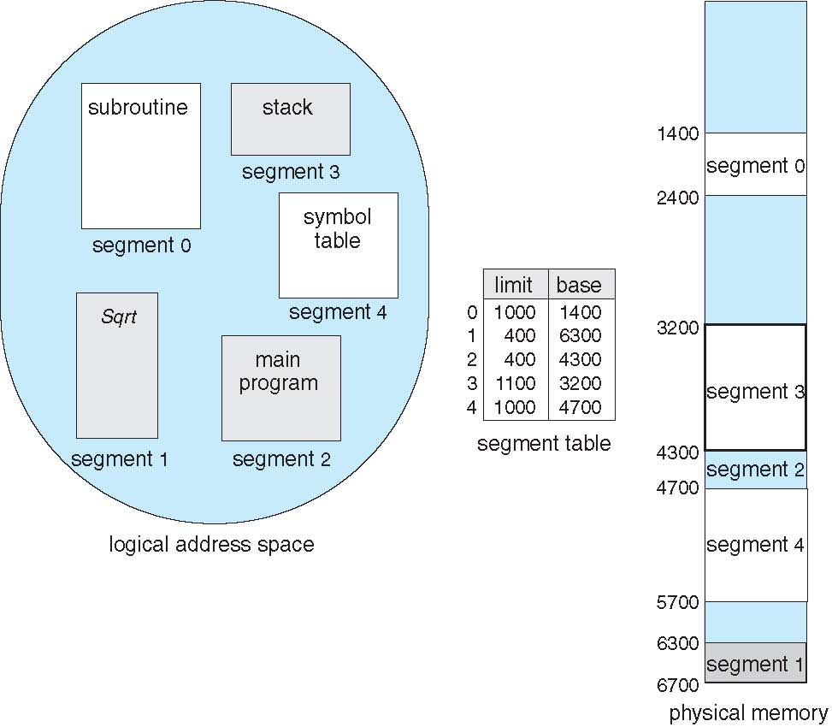
Example of Segmentation

Slide 54
Segmentation Architecture
Logical address consists of a two tuple:
<segment-number, offset>
Segment table – maps two-dimensional physical addresses; each table entry has:
  base – contains the starting physical address where the segments reside in memory
  limit – specifies the length of the segment
Segment-table base register (STBR) points to the segment table’s location in memory
Segment-table length register (STLR) indicates number of segments used by a program;
segment number s is legal if s < STLR

Slide 55
1. Organization of LAS/VAS
Logical address
Logical address space divided into unequal size of segments.
Logical address is divided into two parts
Segment number (s)
Segment offset (d)
<-------------m--------------→
Segment no.
Segment offset
S
d
m-n
n

Slide 56
2. Organization of PAS
No organization of PAS in segmentation.
It is purely variable partition policy

Slide 57
3. Organization of MMU
Number of entries in segment table is equal to number of segments in Logical address space

Slide 58

Segmentation Hardware
If (d(offset) ≤ segment length/limit)
d + base address
Else
segment fault

Slide 59
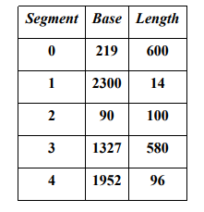
Example
Consider the segment table:
What are the physical address for the following logical addresses :
a) 0, 430 b.) 1, 10 c) 1, 11 d) 2, 500

Slide 60
Solution
219 + 430 = 649
2300+10 = 2310
2300+11 = 2311
Illegal address since size of segment 2 is 100 and the offset in logical address is 500. (Segment fault)

Slide 61
Example-2
Consider the following segment table:
What are the physical addresses for the following logical addresses?
a. 0,430
b. 1,10
c. 2,500
d. 3,400
e. 4,112
Segment | Base | Length
0 | 219 | 600
1 | 2300 | 14
2 | 90 | 100
3 | 1327 | 580
4 | 1952 | 96

Slide 62

Comparison of Segmentation and Paging
PAGING | SEGMENTATION
Fix size | variable size
Internal fragmentation. | No Internal Fragmentation.
Store in CPU register. And TLB. | Store in CPU register.
Process is divide into same size blocked called page | Process divided in variable size blocked segment.
Store in page frame in MM. | Store dynamically in MM.
Page table consists of Page no and frame no. | Every segment has different base and limit. segment table consists of segment no., Base, limit
Logical Add. Consists of Page no and displacement | Logical add. Consists of segment no and displacement.

Slide 63
Virtual Memory
Gives an illusion that a huge amount of memory is available to write program greater than the size of Physical address space(Main Memory).
Virtual memory is a technique that allows the execution of processes that are not completely in main memory.
PAS < VAS < Secondary Storage

Slide 64
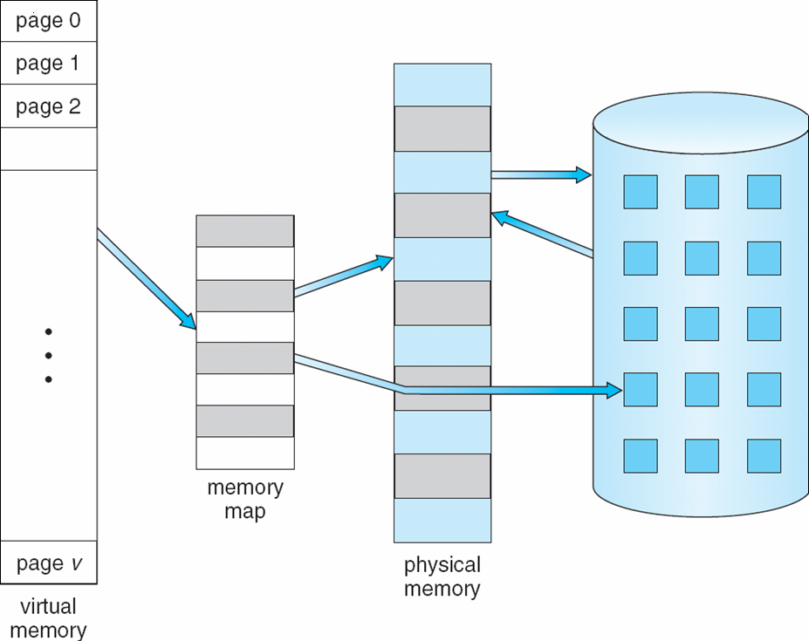
Virtual Memory that is larger than Physical Memory

Slide 65
Background
Virtual memory – separation of user logical memory from physical memory.
  Only part of the program needs to be in memory for execution.
  Logical address space can therefore be much larger than physical address space.
  Need to allow pages to be swapped in and out.
Virtual memory can be implemented via:
  Demand paging
  Demand segmentation
Applied Operating System Concepts

Slide 66
Demand Paging
Bring a page into memory only when it is needed.
  Less I/O needed
  Less memory needed
  Faster response
  More users
Page is needed ⇒ reference to it
  invalid reference ⇒ abort
  not-in-memory ⇒ bring to memory
Applied Operating System Concepts

Slide 67
Valid-Invalid Bit
With each page table entry, a valid–invalid (present-absent) bit is associated
(v ⇒ in-memory, i ⇒ not-in-memory).
Initially valid–invalid bit is set to i on all entries.
Example of a page table snapshot:
During address translation, if valid–invalid bit in page table entry
is i ⇒ page fault.
Page #
valid-invalid bit
v
v
v
v
i
….
i
i

Slide 68
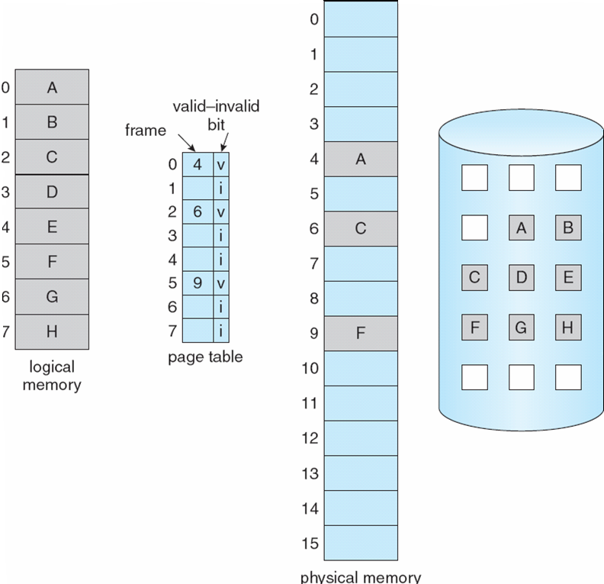
Page Table when some
Pages are not in Main Memory

Slide 69
Page Fault
If there is ever a reference to a page, first reference will trap to
OS ⇒ page fault
OS looks at another table to decide:
  Invalid reference ⇒ abort.
  Just not in memory.
Get empty frame.
Swap page into frame.
Reset tables, validation bit = 1.

Slide 70
What happens if there is no free frame?
Page replacement – find some page in memory, but not really in use, swap it out.
  algorithm
  performance – want an algorithm which will result in minimum number of page faults.
Same page may be brought into memory several times.

Slide 71
Page Replacement
Prevent over-allocation of memory by modifying page-fault service routine to include page replacement.
Use modify (dirty) bit to reduce overhead of page transfers – only modified pages are written to disk.
Page replacement completes separation between logical memory and physical memory – large virtual memory can be provided on a smaller physical memory.

Slide 72
Page-Replacement Algorithms
Want lowest page-fault rate.
Evaluate algorithm by running it on a particular string of memory references (reference string) and computing the number of page faults on that string.
In all our examples, the reference string is
1, 2, 3, 4, 1, 2, 5, 1, 2, 3, 4, 5.

Slide 73
First-In-First-Out (FIFO) Algorithm
Reference string: 1, 2, 3, 4, 1, 2, 5, 1, 2, 3, 4, 5
3 frames (3 pages can be in memory at a time per process)
4 frames
FIFO Replacement – Belady’s Anomaly
  more frames ⇒ less page faults
1
1
4
5
2
2
1
3
9 page faults
3
3
2
4
1
1
5
4
2
2
1
5
10 page faults
3
3
2
4
4
3

Slide 74
Optimal Algorithm
Replace page that will not be used for longest period of time.
4 frames example
1, 2, 3, 4, 1, 2, 5, 1, 2, 3, 4, 5
How do you know this?
Used for measuring how well your algorithm performs.
1
4
2
6 page faults
3
4
5

Slide 75
Least Recently Used (LRU) Algorithm
Reference string: 1, 2, 3, 4, 1, 2, 5, 1, 2, 3, 4, 5
Counter implementation
  Every page entry has a counter; every time page is referenced through this entry, copy the clock into the counter.
  When a page needs to be changed, look at the counters to determine which are to change.
1
5
2
3
5
4
4
3

Slide 76
LRU Algorithm (Cont.)
Stack implementation – keep a stack of page numbers in a double link form:
  Page referenced:
    move it to the top
    requires 6 pointers to be changed
  No search for replacement

Slide 77
LRU Approximation Algorithms
Reference bit
  With each page associate a bit, initially -= 0
  When page is referenced bit set to 1.
  Replace the one which is 0 (if one exists). We do not know the order, however.
Second chance
  Need reference bit.
  Clock replacement.
  If page to be replaced (in clock order) has reference bit = 1. then:
    set reference bit 0.
    leave page in memory.
    replace next page (in clock order), subject to same rules.

Slide 78
Counting Algorithms
Keep a counter of the number of references that have been made to each page.
LFU Algorithm: replaces page with smallest count.
MFU Algorithm: based on the argument that the page with the smallest count was probably just brought in and has yet to be used.

Slide 79
Allocation of Frames
Each process needs minimum number of pages.
Example: IBM 370 – 6 pages to handle SS MOVE instruction:
  instruction is 6 bytes, might span 2 pages.
  2 pages to handle from.
  2 pages to handle to.
Two major allocation schemes.
  fixed allocation
  priority allocation

Slide 80
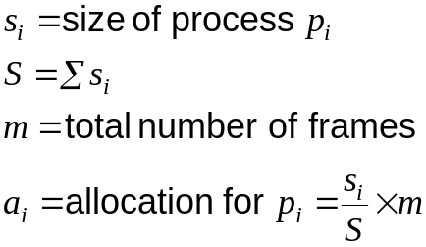
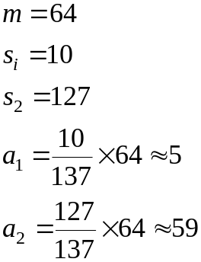
Fixed Allocation
Equal allocation – e.g., if 100 frames and 5 processes, give each 20 pages.
Proportional allocation – Allocate according to the size of process.

Slide 81
Priority Allocation
Use a proportional allocation scheme using priorities rather than size.
If process P_{i} generates a page fault,
  select for replacement one of its frames.
  select for replacement a frame from a process with lower priority number.

Slide 82
Global vs. Local Allocation
Global replacement – process selects a replacement frame from the set of all frames; one process can take a frame from another.
Local replacement – each process selects from only its own set of allocated frames.

Slide 83
Thrashing
If a process does not have “enough” pages, the page-fault rate is very high. This leads to:
  low CPU utilization.
  operating system thinks that it needs to increase the degree of multiprogramming.
  another process added to the system.
Thrashing ≡ a process is busy swapping pages in and out.

Slide 84

Thrashing Diagram
Why does paging work?
Locality model
  Process migrates from one locality to another.
  Localities may overlap.
Why does thrashing occur?
Σ size of locality > total memory size

Slide 85
Working-Set Model
Δ ≡ working-set window ≡ a fixed number of page references
Example: 10,000 instruction
WSS_{i} (working set of Process P_{i}) =
total number of pages referenced in the most recent Δ (varies in time)
  if Δ too small will not encompass entire locality.
  if Δ too large will encompass several localities.
  if Δ = ∞ ⇒ will encompass entire program.
D = Σ WSS_{i} ≡ total demand frames
if D > m ⇒ Thrashing
Policy if D > m, then suspend one of the processes.

Slide 86
Keeping Track of the Working Set
Approximate with interval timer + a reference bit
Example: Δ = 10,000
  Timer interrupts after every 5000 time units.
  Keep in memory 2 bits for each page.
  Whenever a timer interrupts copy and sets the values of all reference bits to 0.
  If one of the bits in memory = 1 ⇒ page in working set.
Why is this not completely accurate?
Improvement = 10 bits and interrupt every 1000 time units.

Slide 87

Page-Fault Frequency Scheme
Establish “acceptable” page-fault rate.
  If actual rate too low, process loses frame.
  If actual rate too high, process gains frame.

Slide 88
Other Considerations
Preparing
Page size selection
  fragmentation
  table size
  I/O overhead
  locality

Slide 89
Other Consideration (Cont.)
Program structure
  Array A[1024, 1024] of integer
  Each row is stored in one page
  One frame
  Program 1 for j := 1 to 1024 do
  for i := 1 to 1024 do
  A[i,j] := 0;
  1024 x 1024 page faults
  Program 2 for i := 1 to 1024 do
  for j := 1 to 1024 do
  A[i,j] := 0;
  1024 page faults
I/O interlock and addressing

Slide 90
Demand Segmentation
Used when insufficient hardware to implement demand paging.
OS/2 allocates memory in segments, which it keeps track of through segment descriptors
Segment descriptor contains a valid bit to indicate whether the segment is currently in memory.
  If segment is in main memory, access continues,
  If not in memory, segment fault.

Slide 91
Thank You

